Slide 1



Knowledge Discover y and Data Mining
Lab 1 Introduction to Python, Anaconda Jupyter Environment
Tianyue Zheng
zhengty@sustech.edu.cn

Slide 2

Python
Python is an interpreted, high-level and general-purpose
programming language.
Created by Guido van Rossum and first released in 1991.
Aims to help programmers write clear, logical code for small and large-scale projects.

Slide 3
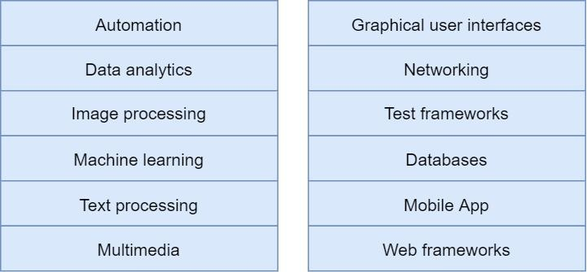
Why to Learn Python?
Easy to learn
Easy to read
Large standard library

Slide 4
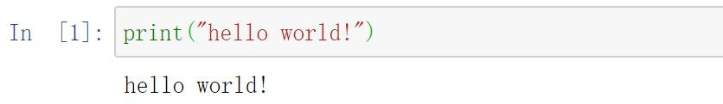
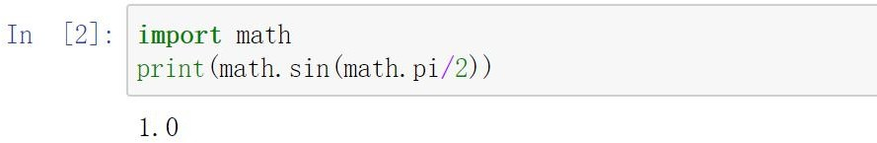
Python Programming Examples
Example 1
Example 2

Slide 5
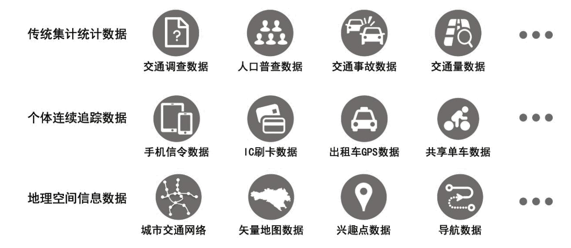

Types of Big Data(example)
Retrieved from: 余庆，李玮峰《交通时空大数据分析、挖掘与可视化》

Slide 6
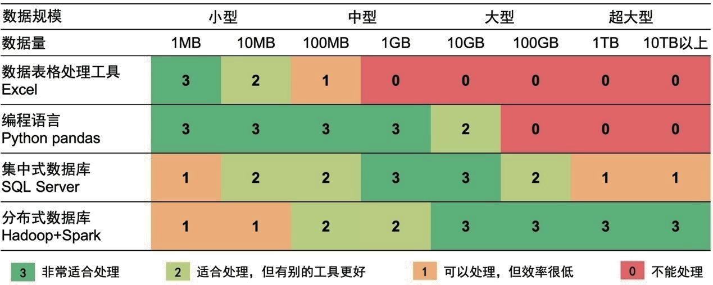
Data Processing Tools
Excel最大仅支持104万行数据！
Retrieved from: 余庆，李玮峰《交通时空大数据分析、挖掘与可视化》

Slide 7

Why Python?
可视化
地理信息处理
数据挖掘
Matplotlib
Shapely
SciPy
数据处理
seaborn
NumPy
GeoPandas
sklearn
Pandas
机器学习
空间统计
TensorFlow
PySAL
PyTorch
交通时空大数据
爬虫
复杂网络
TransBigData
urllib
igraph
NetworkX
BeautifulSoup
Retrieved from: 余庆，李玮峰《交通时空大数据分析、挖掘与可视化》

Slide 8
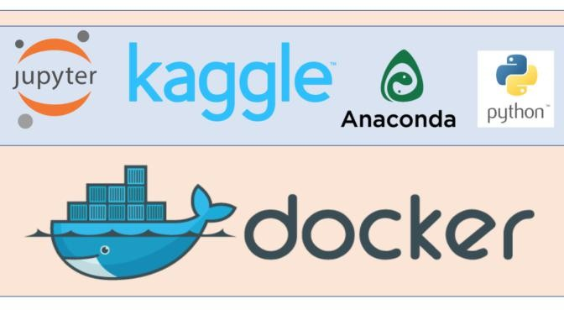


Python Environment
Recommended

Slide 9
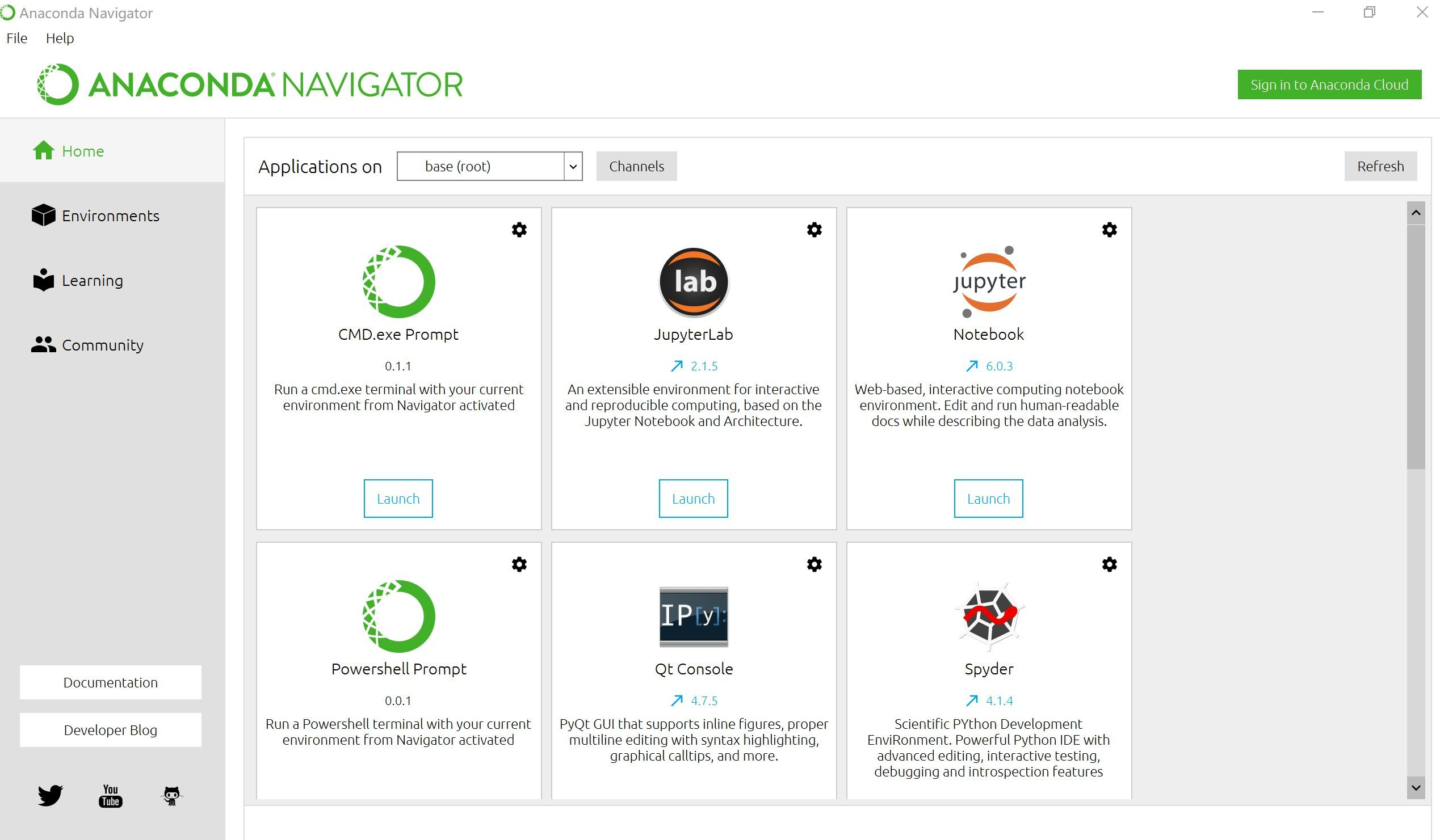
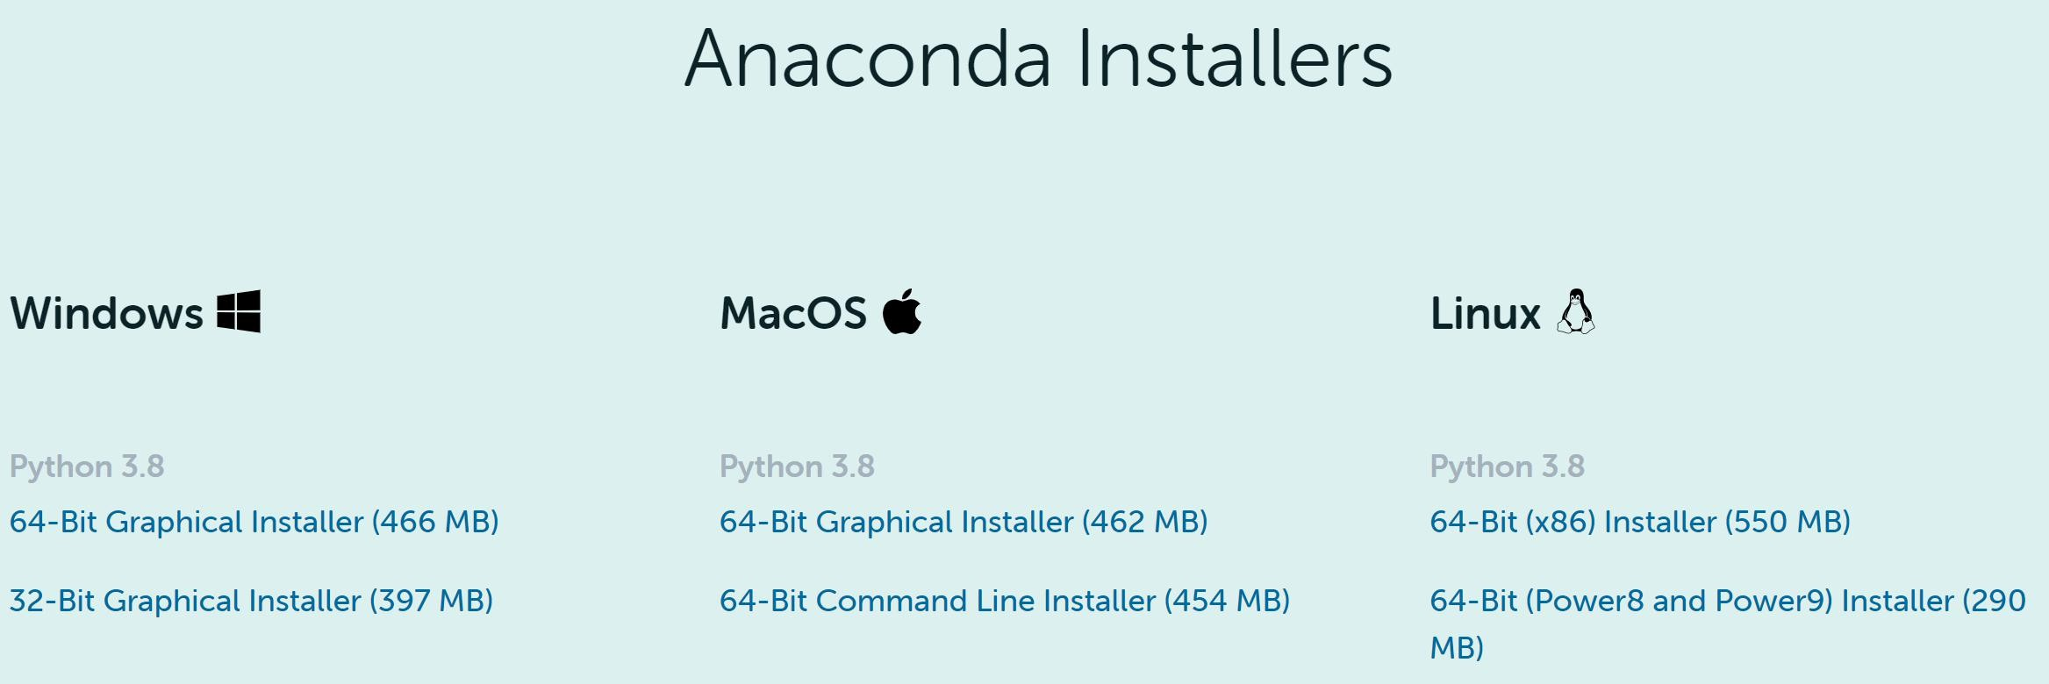
Install Anaconda
Installation of Anaconda
conda create -n your_env_name python=x.x activate your_env_name

Slide 10
Install Jupyter Notebook
Installation of Jupyter notebook
Installing Jupyter using Anaconda and conda
Installing Jupyter with pip
If you have any problem to install Jupyter notebook, you can refer to the following websites:
https://jupyter.readthedocs.io/en/latest/install/notebook-classic.html
https://www.jianshu.com/p/91365f343585

Slide 11
Try to Install Packages
Install some packages
pandas
numpy
matplotlib
scikit-learn

Slide 12
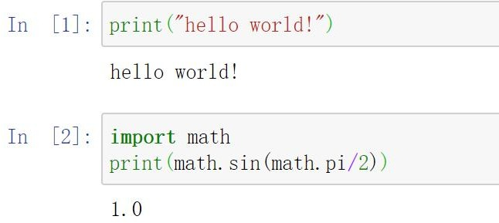
Try to Use Jupyter Notebook
Implement the sample code mentioned in the previous slides.

Slide 13
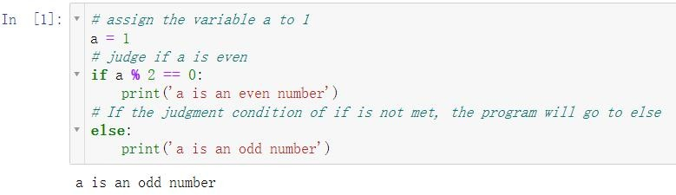
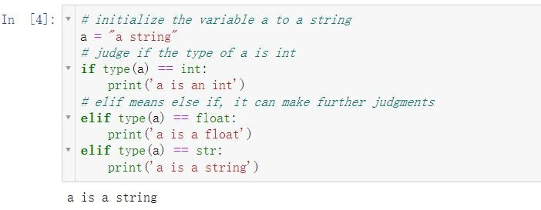
Python Judgement Examples
Example 1
Example 2

Slide 14
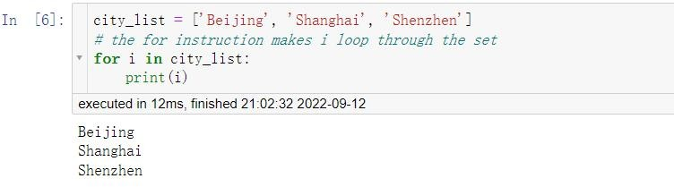
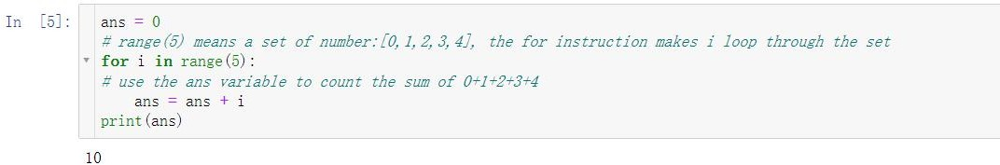
Python Loop Examples
Example 1
Example 2

Slide 15
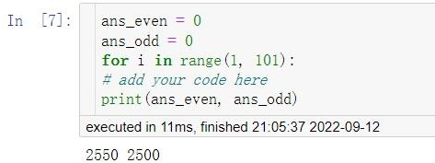
Exercise1
Calculate the sum of all odd and even numbers from 1 to 100.

Slide 16
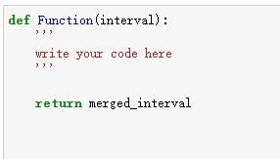
Exercise2
Implement a function in Python that takes a collection of intervals as input and merges all overlapped intervals as output.
Example1:
Input: interval = [[1,3],[2,6],[8,10],[15,18]]
Output: [[1,6],[8,10],[15,18]]
Example2:
Input: interval = [[1,4],[4,5]] Output: [[1,5]]

Slide 17
Exercise3
1. Reading and writing TXT file in jupyter notebook.
2. Reading and writing CSV file in jupyter notebook.
Hints:
txt file:
https://www.geeksforgeeks.org/reading-writing-text-files-python/ https://pythonexamples.org/python-read-text-file/
csv file
https://realpython.com/python-csv/

Slide 18
Other Resources
Python:
https://www.w3schools.com/python/
https://www.runoob.com/python/python-tutorial.html
Anaconda and Jupyter notebook:
https://www.anaconda.com/products/individual/get-started
https://blog.csdn.net/zaishuiyifangxym/article/details/83269834
https://mirrors.tuna.tsinghua.edu.cn/anaconda/archive/
https://juejin.im/post/6844903842497167374
余庆，李玮峰《交通时空大数据分析、挖掘与可视化》清华大学出版社

Slide 19

E n d o f L a b 1

